Slide 1

QER - 5108
QER: BID 141KM SF300065C004.9X - Zeta wire weld crack

Slide 2
Pipe section / Details
Item | Traceability / identification
Project number | SF300065C004
Project name | BID 141KM
Pipe section | SF300065C004.9X
ST number | ST101.51896
Affected layer / equipment | Spiralling
Length affected | 1) 841.8m 2) 5345.5m
Drawing number / MP code / STA / Dimension | Zeta wire 6.2 (MP205)

Slide 3
Overview of anomaly
Problem Description :-
During the zeta spiraling process for BID 141KM SF300065C004.9X (ST10151896), weld crack was detected at length 841.8m and 5345.5m during weld inspection after it was laid on the pipe.
Details of affected weld are as the following:-
- Weld number : 07-20 (Weld from winding process)
- Welding machine : BS13-11
- Bobbin number : 003
- Weld number : 18-11 (During joint bobbin new loading)
- Welding machine : BS13-12
- Bobbin number : 010
Root Cause :-
The root cause is to be investigated.
Problem Handling:-
The defective weld was rejected according to DP-QCP-08DAQT001. Therefore, un-spiraling was performed to remove the defective weld.
1st case at length 841.8m, the affected weld is from winding process.
In addition, based on DI-IND-MET1075, the subsequent welds shall be retrieved if reachable for the test and analysis. The subsequent welds were gone through the tensile test, and the result is detailed below.
Tensile results for the subsequent welds:-
- Weld 06-20 (N-1) : 640.1mPa
- Weld 10-20 (N+3) : 612.9mPa
The minimum criteria for the tensile test are 530mPa.
To note that, N+1 and N+2 welds are not retrievable due to have been laid on pipe at length 614.1m and 651.8m.
2nd case at length 5345.5m, the affected weld is a joint bobbin new loading.
In addition, based on DI-IND-MET1075, the subsequent welds shall be retrieved if reachable for the test and analysis. The subsequent welds were gone through the tensile test, and the result is detailed below.
Tensile results for the subsequent welds:-
- Weld 17-11 (N-1) : 601.0mPa
The minimum criteria for the tensile test are 530mPa.

Slide 4
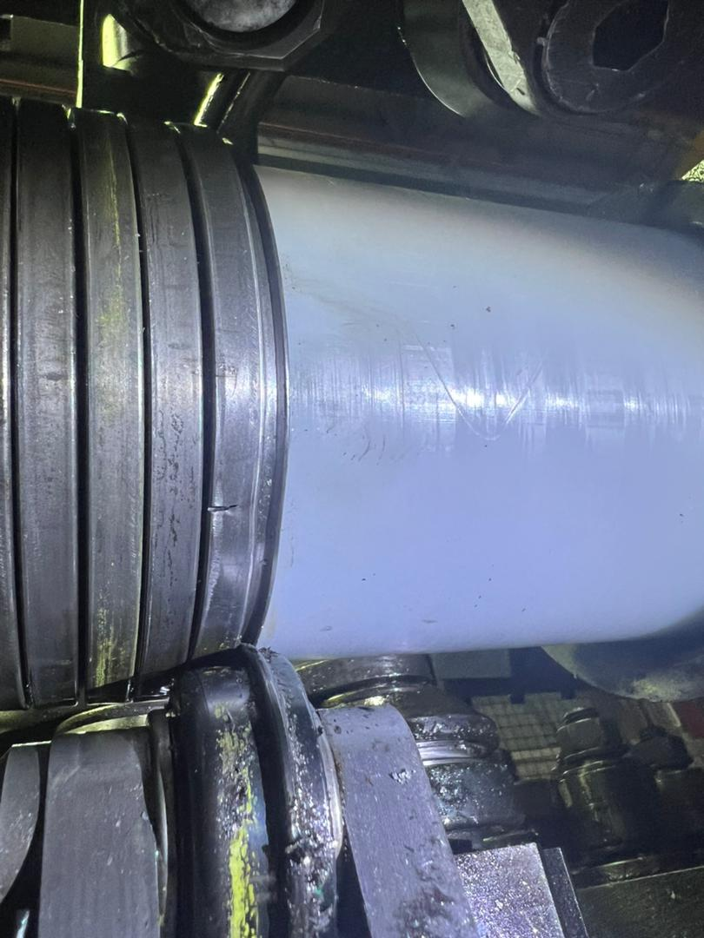
Zeta wire weld crack at length 841.8m
Figure 1 : Zeta wire weld crack was detected at length 841.8m during weld inspection after it was laid on the pipe.

Slide 5
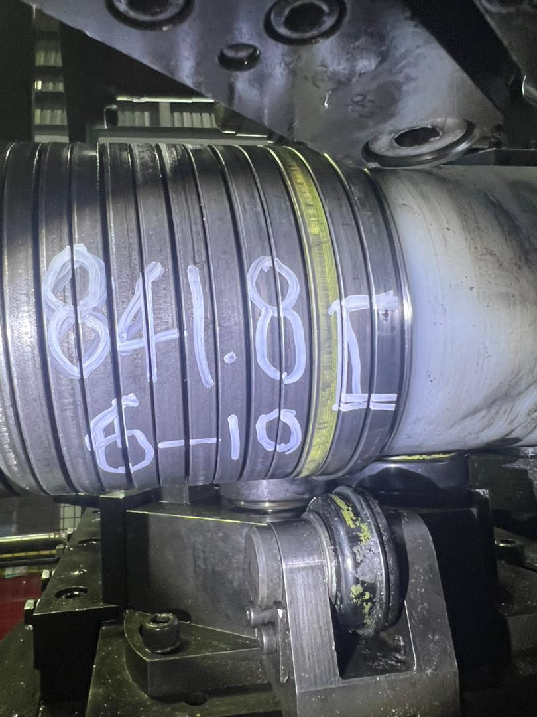
Photo after repaired
Figure 2 : Un-spiraling was performed to remove the defective weld and replaced with weld 08-10 from (BS13-12).

Slide 6
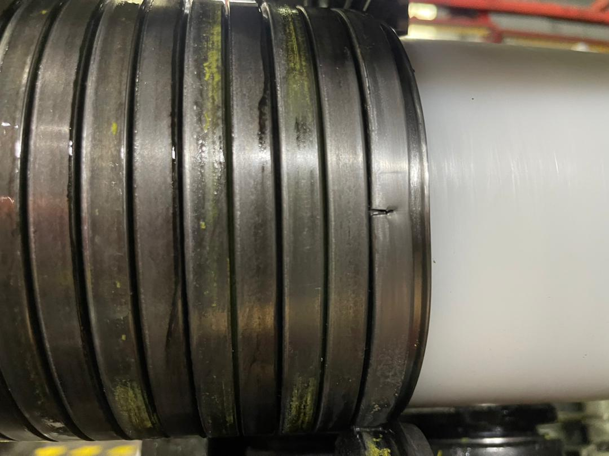
Zeta wire weld crack at length 5345.5m
Figure 3 : Zeta wire weld crack was detected at length 5345.5m during weld inspection after it was laid on the pipe.

Slide 7
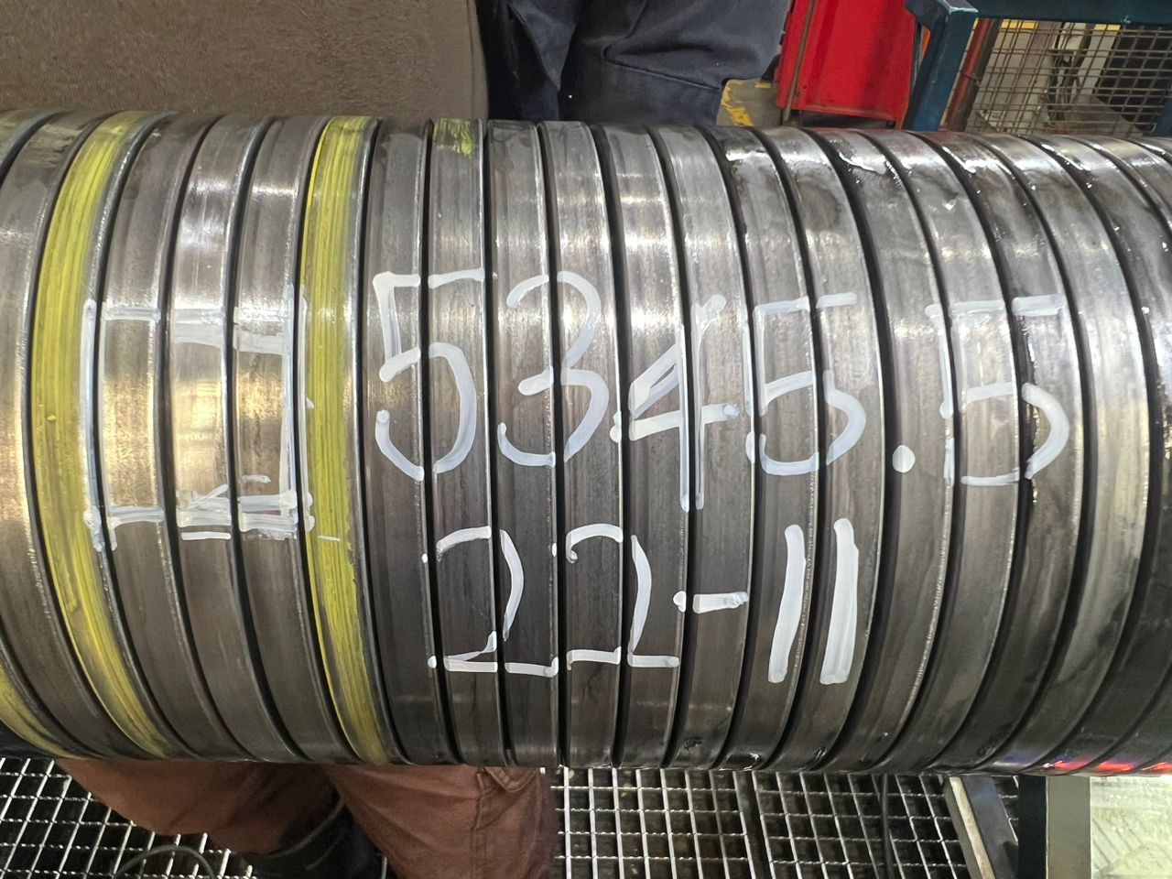
Photo after repaired
Figure 2 : Un-spiraling was performed to remove the defective weld and replaced with weld 22-11 from (BS13-12).

Slide 8

THANK YOU

